Slide 1
Detecting High Risk Taxpayers Using Data Mining Techniques
Guided By
Prof. ABC
Group Members
1.
2.
3.
4.

Slide 2
ABSTRACT
Taxpayer means as the name refers to a person or organization who wants to pay a specific amount or tax to the government on its income. Risk refers to loss of anything, but look at from the angle of government tax its a avoid of paying tax on time. Sometimes, On purpose people show their income low to avoid the government tax.
Hiding information of buying ,selling of properties in the form of lands it's also one type of risk in government tax. Because of these risks, the government suffers from a lot of difficulties during the audit period. Government faces the challenge of identifying and collecting taxes that have successfully hidden from paying the proper tax; it's also called as Tax fraud. Sometimes, Taxpayers misrepresent the financial facts to the government, is also tax fraud.
The main purpose of this system is to design and find out the high risk taxpayers and notify the amount of tax to the high risk taxpayers so that it would never forget to pay the government tax. In this system, various methods are used like Classification, Association, Regression, Data mining to detect the high risk taxpayers.
This system classifies the risk according to how much tax the person wants to pay. This tax is associated with the person based on their income. High risk taxpayers means the person who wants to pay a high amount of tax. If these taxpayers are increasing day by day, the government wants to suffer economic problems in our country and how the government works for our country. Therefore, this system is helpful not only to detect the high risk taxpayers but also to resolve this drawback

Slide 3
INTRODUCTION
Tax fraud is a major issue that incurs expenses in terms of the loss of government revenues, those results in less economical tax programs and therefore the inequity between fraud taxpayers and honest taxpayers.
Tax Administration is under increasing pressure, since the monetary crisis of 2008 and therefore the massive deficits that followed, to collect extra tax revenues and cut back commercial enterprise fraud. Effective management of tax fraud requires addressing a basic applied mathematics drawback of non-detection, which may bias estimates of the quantity of fraud and therefore the relative fraud propensities of various social economic teams.
Tax fraud detection involves processing an oversized quantity of information in search of fraud behavior that needs quick and economical algorithms, among that data processing provides relevant techniques that may facilitate tax administration to take preventive measures and improve tax style.
Financial fraud detection tools are delivered to scenic in order to deal with this drawback and to produce reliable solutions to business. is often fraud is generally discovered through outlier detection method enabled by data processing techniques, that also determine valuable info by revealing hidden trends, relationships, patterns found in an exceedingly large database.
Data processing, defined as “a method that uses statistical, mathematical, artificial intelligence, and machine learning techniques to extract and determine helpful information and subsequently gain information from an outsized database”, could be a major contributor for detecting differing types of financial fraud through its numerous ways, such as, logistic regression, decision tree, support vector machine (SVM), neural network (NN) and naïve bayes. a number of these techniques exceed the others in specific financial contexts. Glancy and Yadav (2011) divide those contexts to a few main areas: internal, insurance and credit. Jans et al

Slide 4
INTRODUCTION
(2011) additional classify internal fraud into 2 categories: budget fraud and dealings fraud . They define financial statement fraud as “the intentional statement of sure money values to reinforce the appearance of profitability and deceive shareholders or creditors” whereas transaction fraud captures the method of snatching organizational assets.
Auditing tax declarations could be a slow and expensive method, so that tax authorities are required to develop efficient ways to tackle this drawback and improve tax style. This issue motivates our proposal. In our analysis we have a tendency to explore the relevancy of the info mining techniques in developing a segmentation model which will contribute to tax style evaluation and therefore the characterization of the segments of potential fraud taxpayers within the Personal Income Tax.
Despite the rise within the use of those screening and classification models for police work fraud patterns homeward-bound at audit designing, there are not any studies that focus on the identification of tax advantages within the taxation structure that area unit a lot of doubtless to be utilized by potential fraud taxpayers. to boot, this proposal to phase and characterize potential dishonorable taxpayers also can be applied to differing kinds of taxes.
Data mining techniques are used in this system like regression, classification, clustering.

Slide 5
To detect financial fraud using data mining tools within one decade and communicate the current trends to academic scholars and industry practitioners.
Objectives of the project
The objectives of the systems development and event management are:
To apply a data mining technique to enhance government tax evasion detection performance.
Using a data mining technique, a screening framework is developed to filter possible non-compliant value-added tax (VAT) reports that may be subject to further auditing.
To explore how tax administrations could make use of data mining to enhance tax compliance among the taxpayers.
To encourage improvement in tax administration.
To avoid misrepresenting the financial fact or tax to the government.
To have a system that supports the tax administration of cases and tasks.

Slide 6
Scope of project
Tax evasion is mostly performed by the taxpayers to reduce tax liability and this illegal action is usually performed to misrepresent the financial facts to the government. This system is used to detect high risk taxpayers who avoid paying personal tax. This system uses data mining techniques. The main aim of this analysis is to explore data mining techniques for fraud tax prediction. In data mining techniques, problems like tax fraud detection are usually framed as classification problems, predicting a discrete class label output given a data observation.The main data mining techniques used for tax fraud detection are logistic models, artificial neural networks, the Bayesian network, and decision trees.

Slide 7
Methodology
Decision tree :-
Decision tree build classification or regression models in the form of a tree structure. It breaks down a dataset into smaller and smaller subsets while at the same time an associated decision tree is incrementally developed. The final result is a tree with decision nodes and leaf nodes. A decision node (e.g., Outlook) has two or more branches (e.g., Sunny, Overcast and Rainy). Leaf node (e.g., Play) represents a classification or decision. The topmost decision node in a tree which corresponds to the best predictor called root node. Decision trees can handle both categorical and numerical data.
SVM (support vector machine) :-
A support vector machine (SVM) is a supervised machine learning model that uses classification algorithms for two-group classification problems. After giving an SVM model sets of labeled training data for each category, they’re able to categorize new text.
Naive Bayes :-
A classification algorithm under supervised learning group based onprobabilistic logic. This is one of the simplest machine learning algorithms of all times. Generative algorithms from GANs are also used as classifiers, interestingly they can do much more than categorisation though.

Slide 8
Existing system
In our Existing system, Based on the analysis of the reviewed articles during this space, it's able to classify tax fraud at a high-level into four major classes, namely, budget fraud, bank fraud, and different connected money fraud.
It shows the amount of articles found in every form of money fraud whereas the little items of the chart represent those numbers in percentages.
It's evident that budget fraud and bank fraud represent the largest portion; this proportion corresponds to forty one articles out of the sixty five reviewed articles.
The projected classification framework will work as a reference in guiding money fraud. Detection analysis through providing assistance to students in distinctive areas that need additional attention.
This framework can even give trade professionals associate indexes to pick out the appropriate data mining technique for a particular context of monetary fraud.
For instance, firms that suffer from MasterCard fraud, they need the associate possibility of using any of the supervised learning tools (i.e. clustering, neural network, and SVM) and it's suggested to go with the foremost frequently used technique; call tree. As noted, this choice relies on the fraud context and data processing technique frequency however it will be additionally supported performance.

Slide 9
Disadvantages of Existing system
System is not précised.
Detecting area is limited.

Slide 10
Proposed system
The proposed classification framework will work as a reference in guiding financial fraud detection analysis through providing the help to determine the demanding areas that require more attention.
This framework can even provide business professionals an index to pick the acceptable data mining technique for a particular context of financial fraud.
for instance, companies that suffer from credit card fraud, they need an choice of employing any of the supervised learning tools (i.e., naïve bayes, decision tree, neural network, and SVM) and it's suggested to travel with the most frequent used technique; decision tree. As noted, this selection is based on the fraud context and data mining technique frequency

Slide 11
Advantages of Proposed system
This method is used to detect high risk taxpayers in a minimum amount of time.
The power of this system is the combined use of regression techniques, support vector machines and prioritizing the high-income taxpayers.
The main feature is the amount of taxable income based on which the purchasing, sales, revenue and profit can be calculated.
This system Discovers fraud tax payers with potential tax responsibility and Improving compliance of tax deductors.

Slide 12
HARDWARE and SOFTWARE REQUIREMENT
Hardware:
Processor: Intel Core i3 or more.
RAM: 4GB or more.
Hard disk: 250 GB or more.
Software:
Operating System : Windows 10, 7, 8.
Python.
Anaconda.
Spyder, Jupyter notebook, Flask.
MYSQL.

Slide 13
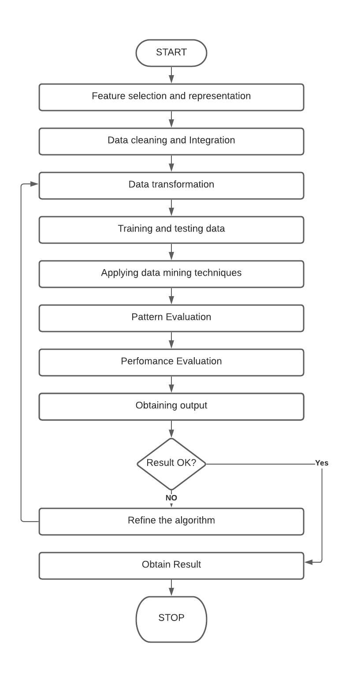
FLOWCHART

Slide 14
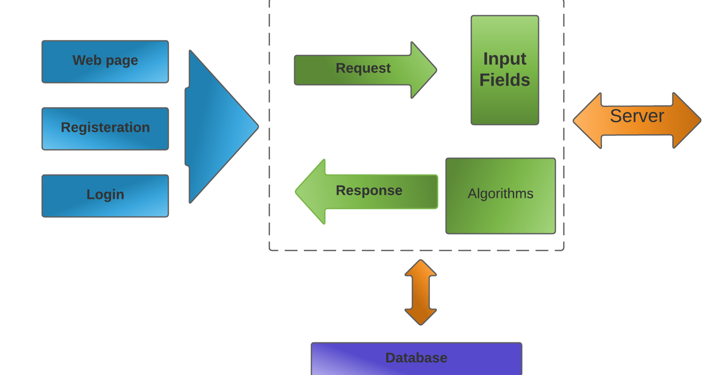
Architecture diagram

Slide 15
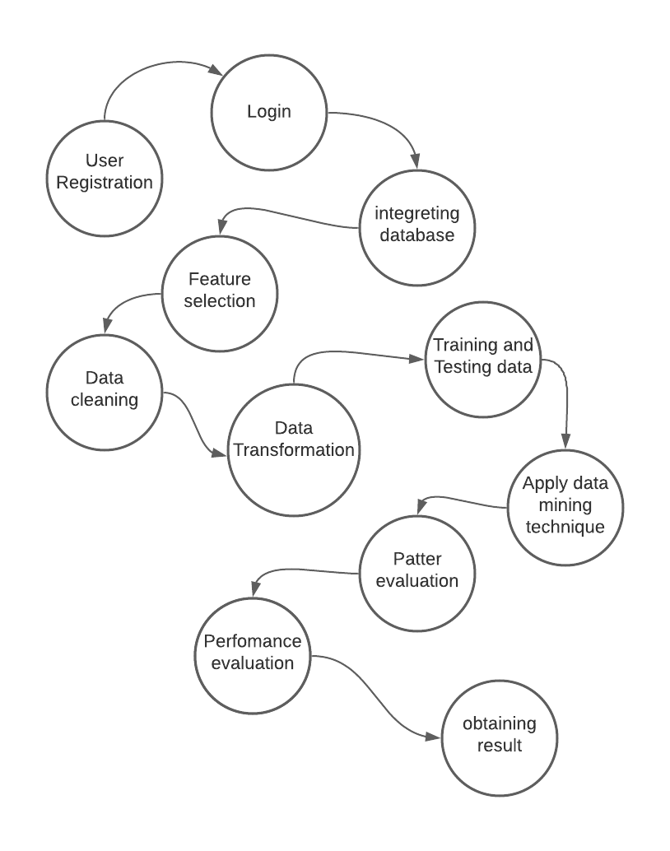
DFD Level 1

Slide 16
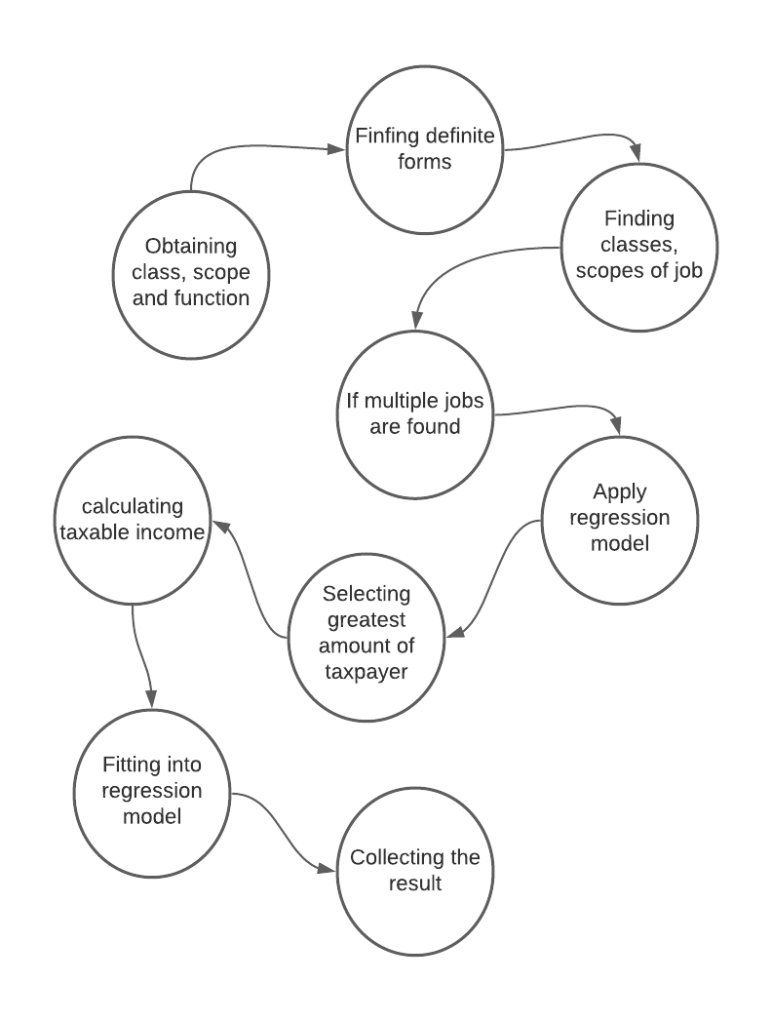
DFD Level 2

Slide 17
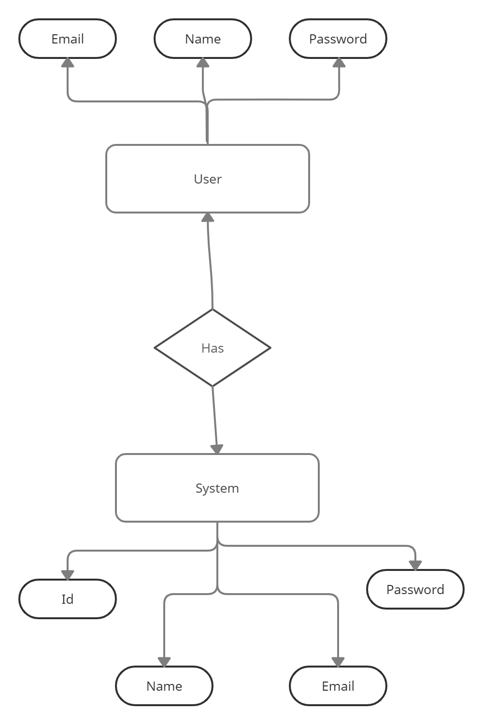
E-R Diagram

Slide 18
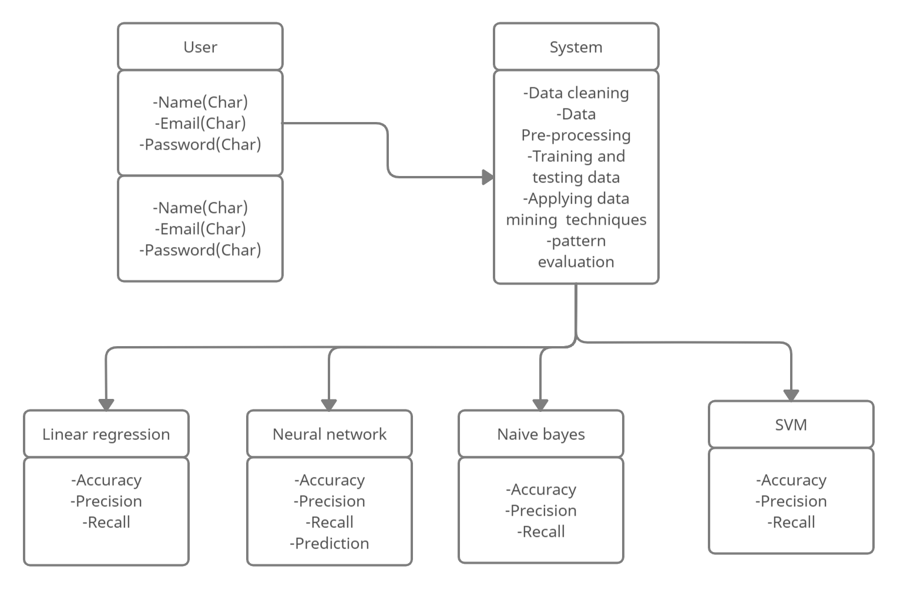
Class diagram

Slide 19
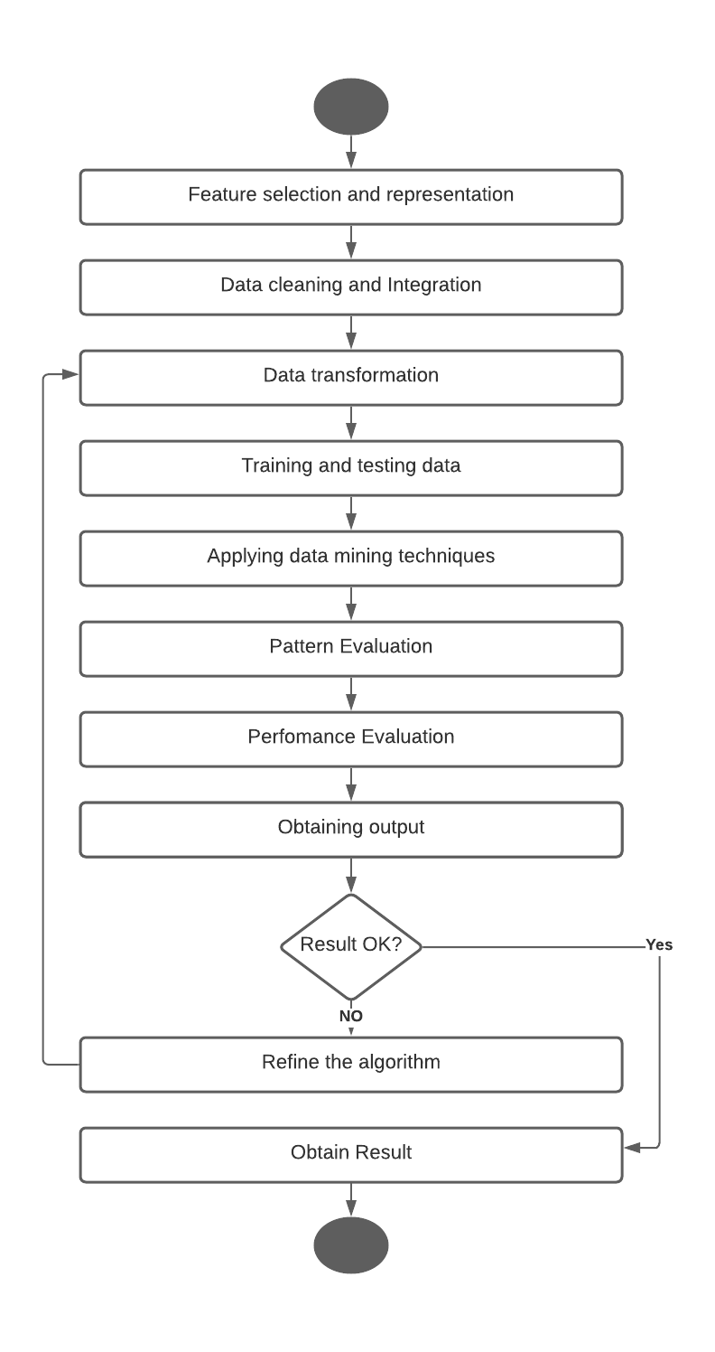
Activity diagram

Slide 20
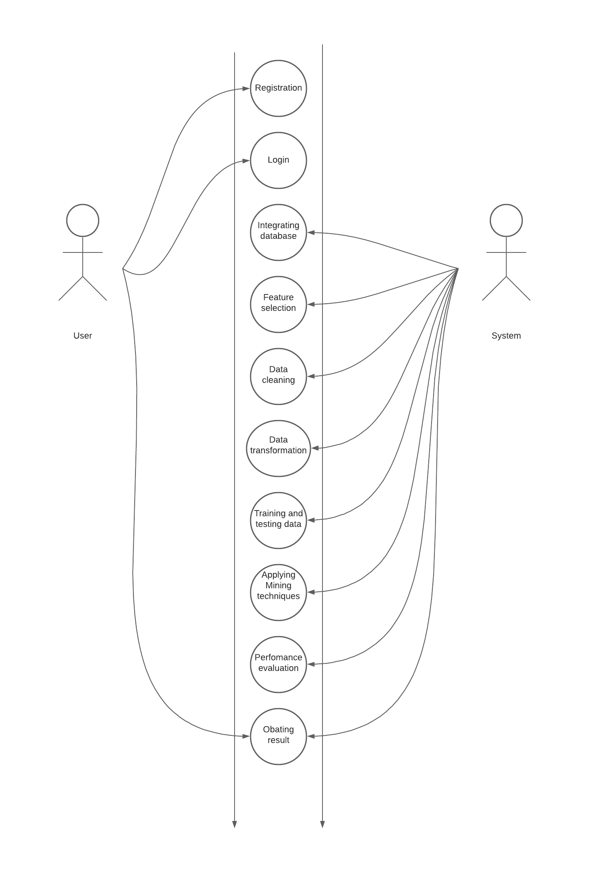
Use case diagram

Slide 21
FUTURE MODIFICATIONS
Tax evasion is mostly performed by the taxpayers to reduce tax liability and this illegal action is usually performed to misrepresent the financial facts to the government. This system is used to detect high risk taxpayers who avoid paying personal tax. This system uses data mining techniques. The main aim of this analysis is to explore data mining techniques for fraud tax prediction. In data mining techniques, problems like tax fraud detection are usually framed as classification problems, predicting a discrete class label output given a data observation.The main data mining techniques used for tax fraud detection are logistic models, artificial neural networks, the Bayesian network, and decision trees.

Slide 22
Conclusion
Various strategies are enforced to extract the high risk taxpayers however in apply the colorful taxpayers’ formula given the most effective result compared to the mean variance, job factor, quantity based and modification based methods. The facility of this technique is that the combined use of regression techniques, support vector machine and prioritizing the high-income taxpayers.

Slide 23
THANK YOU

